Slide 1
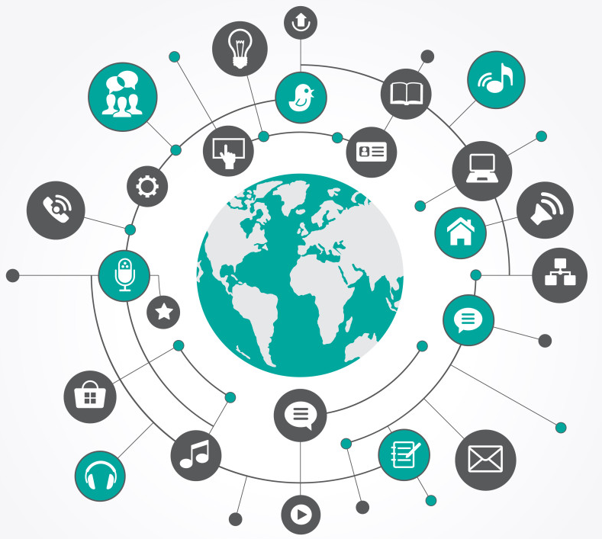
IoT
(Internet
of
Things)

Slide 2
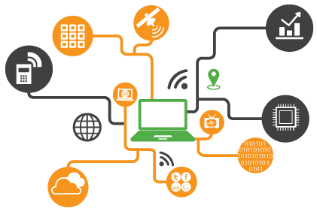
What is IoT ?
A system of interrelated computing devices, mechanical and digital machines, objects, animals or people that are provided with unique identifiers (UIDs) and the ability to transfer data over a network without requiring human-to-human or human-to-computer interaction

Slide 3
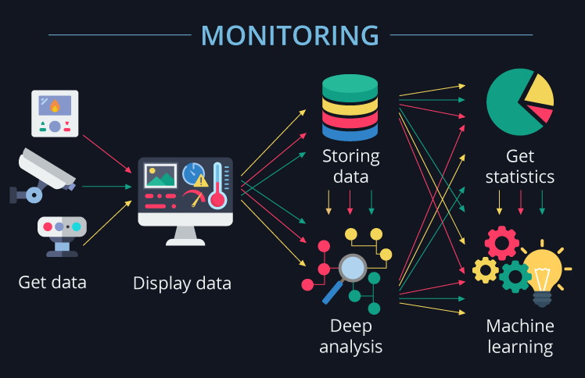

Slide 4
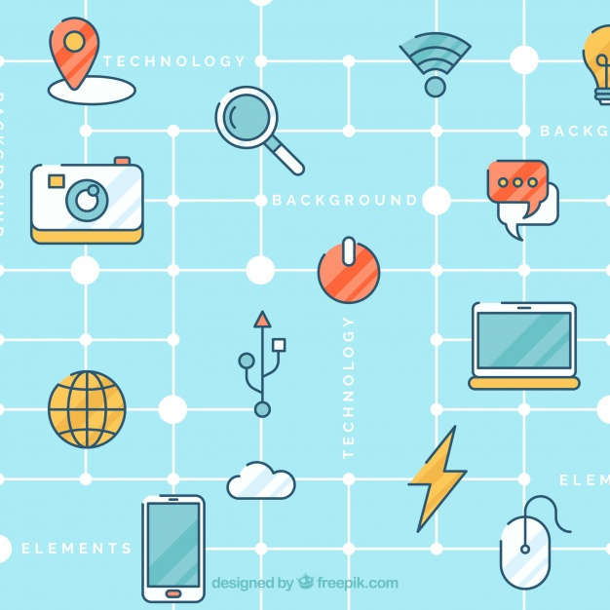
More
Examples
Smart Home
Uber
Fitness Gadget
Smart Agriculture
IoT Analytics
Barcode System
Shopping Center
Tags
Weather Station

Slide 5

What will we
do in this workshop ?

Slide 6
Agendas
Understand the IoT concept and real life applications
Difference between microprocessor and microcontroller
Architecture and application areas of IoT
Use and functionality of sensors used in IoT applications
Understand the benefits of Internet of Things and how it makes our life easier

Slide 7
Day 1
1.1 | Introduction to Microcontroller
1.2 | Difference between Microcontroller and Microprocessor
1.3 | Introduction to NodeMCU ESP8266
1.4 | IDE Installation and Configuration
1.5 | Overview of Arduino IDE
1.6 | Program Structure
1.7 | First Blink Sketch

